Slide 1
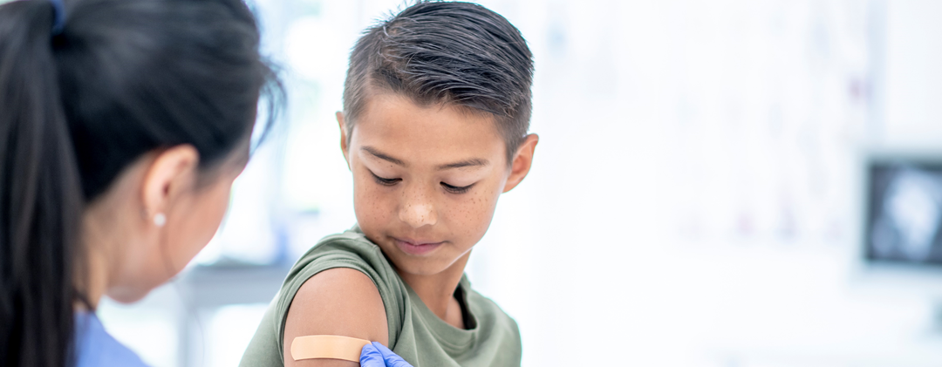
Identifying barriers and facilitators to pharmacy-based HPV vaccination using the Consolidated Framework for Implementation Research (CFIR): A qualitative analysis from pharmacists and pharmacy managers in Canada and US

Slide 2
Disclosures
Funding
Funding for this research was provided by Merck Sharp & Dohme LLC, a subsidiary of Merck & Co., Inc., Rahway, New Jersey, USA.
Presenter conflict of interest
I am an employee of MSD.

Slide 3
Overview
Background
Study Overview
Results and Discussion
Describe the implementation of HPV vaccination in US and Canada pharmacy settings
Identify barriers and facilitators to HPV vaccination implementation at the pharmacy level

Slide 4
Background
Global HPV-related Cancer Burden
4.5%
570,000 new cases in women, 60,000 in men annually
Canada and US
61.% US adolescent (2023)
64% Canada adolescent (2023)
Vaccine Rates Suboptimal
Pharmacy HPV Vaccination
Policies that allow pharmacy-based HPV vaccination
16 countries
Access Opportunity
13 million in US and 6.5 million Canadians PCP shortage area
HPV vaccination delivery, particularly in rural communities
90-95% of People
90-95%
Live within 5 miles from a community pharmacy
Notes:
Global Cancer Burden:
HPV accounts for ~4.5% of all cancers (570,000 new cases in women; 60,000 in men annually).
de Martel C, Plummer M, Vignat J, Franceschi S. Worldwide burden of cancer attributable to HPV by site, country and HPV type. Int J Cancer. 2017;141(4):664-670. doi:10.1002/ijc.30716
Cervical cancer resulted in ~311,000 deaths in 2018.
Vaccination Status:
HPV vaccine approved by FDA in 2006; vaccination rates remain sub-optimal despite its effectiveness.
US Data:
Canada Data: Perez, S. (2024). Progress and Challenges in Canada’s Path Toward the Elimination of Cervical Cancer. Current Oncology, 31(10), 5850-5861
Access Challenges:
Limited access to vaccination services is a key barrier.
Expanding vaccination settings and providers can enhance coverage (evidence from US & Canada).
Role of Pharmacies:
Pharmacists play a critical role as immunizers, especially highlighted during the COVID-19 pandemic.
Nearly 90% of residents live within 5 miles of a pharmacy, improving access in low-coverage areas.
Current Interventions:
Pharmacy-based immunization significantly raises vaccination rates for adults; limited data on adolescents.
16 countries, including the US and Canada, have pharmacy-based HPV vaccination policies. (Argentina, Australia, Brazil, Us, Canada, Switzerland, costa Rica, Denmark, France, UK, Ireland, Norway, New Zealand, Philippines, Portugal, South Africa)
Source: Microsoft Power BI—International Pharmaceutical Federation (FIP) –10 have prescriptive authority.

Slide 5
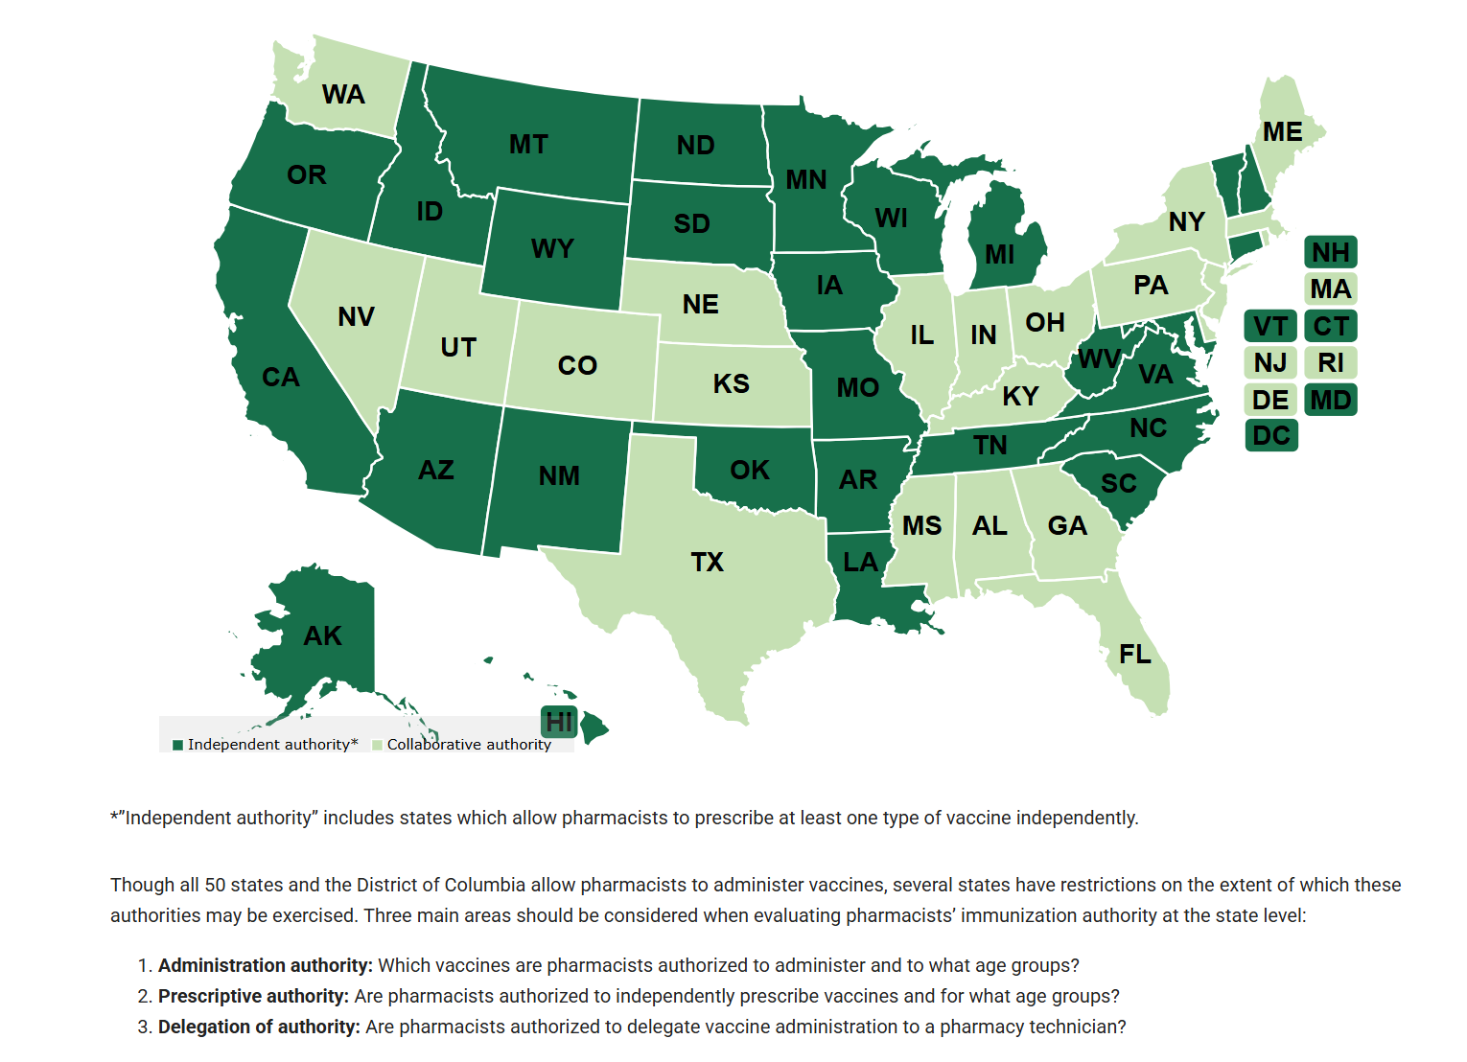
Background, US Pharmacy Administration
Notes:
In Canada, administrative authority in all 10 provinces (not in two territories: NWT and NU)
InjectionVaccinationScan_Feb2024_EN.pdf

Slide 6
Study overview
Goals
To describe the implementation of HPV vaccination in global pharmacy settings
To identify barriers and facilitators to implementation at the pharmacy level
Design
Sample
Data
Timeline
Qualitative exploratory study
In-depth semi-structured interviews
Two countries (US and Canada)
32 Pharmacists Pharmacists/Pharmacy managers in US and Canada with on-site vaccination
Interviewees were recruited through phone calls, emails, and community networks
Incentive of $150
.
Data Collection/Analysis Semi-structured CFIR-guided virtual interviews (60 min)
Nvivo (14.23.0)
Deductive thematic (CFIR) and qualitative content analyses
Study Period
Interviews: July – Nov 2023
Analysis: Dec 2023 – Jan 2024
Health Media Lab IRB Approval (#2304)| June 27, 2023
Notes:
These countries were selected because 1) they have a policy in place that supports pharmacists or physicians to vaccinate adolescents and adults for HPV within pharmacies and 2) there are pharmacies currently offering HPV vaccination. Inclusion criteria for participants were pharmacists and/or pharmacy managers currently employed at a US or Canadian pharmacy that was currently administering HPV vaccines on-site.
Assessment of theme variation by country, pharmacy type, and setting (rural, suburban, urban).

Slide 7
Background: Consolidated Framework for Implementation Research (CFIR)
Conceptual framework commonly used in implementation science research to guide systematic assessment of factors that might influence intervention implementation (Damschroder et al, 2009).
1
2
3
4
5
Intervention Characteristics
Inner Setting
Outer Setting
Individual Characteristics
Implementation Process
Notes:
The CFIR is commonly used to guide exploratory analyses of factors influenced implementation procedures and outcomes.

Slide 8
Concepts in interview guide, by CFIR domain
CFIR Domain | Concepts discussed during interviews
Participant demographics | Age Education level and training Employment status Pharmacy-specific experience and professional organization membership
Outer setting (economic, political, and social context of pharmacies) | Local policies impacting pharmacy-based HPV vaccination and implementation Social attitudes towards HPV vaccine Role of professional organizations
Inner setting (within-pharmacy characteristics) | Implementation climate (internal leaders, change-agents, attitudes towards change) Cultural norms
Individual characteristics | Knowledge of HPV vaccine evidence basis Perception of HPV vaccination as a priority Rewards and incentives for vaccination Impacts of training Opinions on patient communication regarding HPV vaccine
Process | Details of planning of pharmacy-based HPV vaccination rollout Changes over time in delivery of HPV vaccines Adaptations to vaccination priorities (e.g. “less than ideal” outcomes) Comparison of experience with HPV vaccines to other vaccines Communication between pharmacists and primary care providers (e.g., updates to vaccine records)

Slide 9
Characteristics of study sample
 | Canada (n=16) | US (n=16)
Province or State | Nova Scotia (2) Manitoba (3) Toronto (2) Saskatchewan (2) British Columbia (3) Newfoundland (3) Alberta (1) | New Jersey and Pennsylvania (2) Illinois (2) Illinois and Arizona (1) Ohio (1) Virginia (1) Texas and Oregon (1) Michigan (1) California (1) Arizona (1) Texas (1)
Ownership | 6 chain 10 independent | 11 chain 5 independent
Role | 9 pharmacists 7 pharmacy managers * | 4 pharmacists 12 pharmacy managers*
Urbanicity | 2 rural 14 urban | 3 rural 8 urban 5 suburban
* All pharmacy managers had previously trained and worked as pharmacists. These respondents all concurrently performed pharmacist responsibilities on an ad-hoc basis. We asked pharmacy managers questions that were specifically related to their roles as managers, but their responses may also reflect their previous and concurrent experiences as pharmacists.
Notes:
Canada: 7 of 10 provinces
US: 13 states

Slide 10
Consolidated Framework for Implementation Research (CFIR)
Conceptual framework commonly used in implementation science research to guide systematic assessment of factors that might influence intervention implementation (Damschroder et al, 2009).
1
2
3
4
Inner Setting
Outer Setting
Individual Characteristics
Implementation Process
Notes:
The CFIR is commonly used to guide exploratory analyses of factors influenced implementation procedures and outcomes.

Slide 11
Results
Inner Setting: Structural characteristics, networks, communication, implementation climate (Damschroder et al, 2009).
It was a blip on our radar really. We were already doing a lot of vaccines, and so storing HPV would be like storing any other vaccine… it didn't affect our workflow at all.” (US, Virginia, urban, ind.)
It isn't necessarily training or education, it’s
just kind of . . . how do we become a little
more proactive and engaging about this
vaccine as opposed to reactive .” (US, Ohio,
rural, pharmacy manager, chain)
1
Operational Changes Minimal changes required in pharmacies already providing vaccinations; HPV often added to existing services.
Patient Eligibility Confirmed through physician referrals and immunization information systems (IIS); however, many noted incomplete data in these systems.
Training Limited specific training for HPV vaccination; chain pharmacies used corporate materials, while independents relied on self-directed learning.
Inner Setting
Notes:
The CFIR is commonly used to guide exploratory analyses of factors influenced implementation procedures and outcomes.

Slide 12
Results
Outer Setting: Policies and laws, values/beliefs, systemic conditions, partnership, financing (Damschroder et al, 2009)
At the end of the day, a lot of people in Canada don't even have a doctor or access to a physician. And then even if they do, they're not going to book an appointment to talk about what vaccines they need. They're going to talk about like why their knee hurts or things like that. . . (Canada, British Columbia, urban, chain pharmacy)
2
Patient Needs Convenience and personal relationships cited as key facilitators
Role of Pharmacists Pharmacists see themselves as filling healthcare gaps, driven by provider shortages, especially in Canada
Vaccine Costs High costs pose barriers for uninsured individuals in the US
Buying and storing multi-dose boxes, challenge for independents
Canadian pharmacies often waive fees for eligible patients
.
Outer Setting
Notes:
The CFIR is commonly used to guide exploratory analyses of factors influenced implementation procedures and outcomes.

Slide 13
Results
Individual Characteristics: Knowledge and beliefs, self-efficacy, and personal attributes (Damschroder et al, 2009).
Just being clear on all the types of cancers that [the vaccine] can prevent and, uncomfortable as it is, preventing genital warts. Even with safe sex practices, things can still happen. . . [This] is another line of defense ... (Canada, Saskatchewan, rural, ind.)
. . .when conversations came up organically, they (staff) would be prepared to have an educated conversation.” (US, Ohio, rural, chain)
3
Promotion Approach Mixed responses on HPV promotion; some pharmacists passionate about cancer prevention, MOST were reactive rather than proactive
Messaging Comfort in discussing HPV; educational conversations emphasized cancer prevention benefits. Some biases noted regarding patient interest in vaccination
Patient Awareness
Chain pharmacies were more likely to use resources from parent companies for promotional efforts
Independent pharmacies reported creating their own promotional materials (social media posts, blogs, newsletters, flyers)
Individual Characteristics
Notes:
The CFIR is commonly used to guide exploratory analyses of factors influenced implementation procedures and outcomes.

Slide 14
Results
Implementation Process: Planning, execution, reflection, evaluation (Damschroder et al, 2009).
Pharmacists have “a million other things to do and finding time to actually initiate that phone call” is a challenge.
4
PCP Communication Minimal communication with primary care provider (PCP) in advance of administration
Belief that PCP should recommend the vaccine
Reporting Use of immunization information systems (IIS) not a burden in US, but not possible in Canada.
In Canada, Pharmacists reported manually faxing records to local health departments
Patient Reminder Chain pharmacies reported automated reminder systems.
Some ind. pharmacies used manual reminder approaches (calling)
Staffing time barriers
Process
Notes:
The CFIR is commonly used to guide exploratory analyses of factors influenced implementation procedures and outcomes.

Slide 15
Conclusions
Pharmacist as Vaccinators Despite varying cultural and policy environments, pharmacists in both the US and Canada feel capable of providing HPV vaccinations as part of existing workflow.
Operational Complexities Challenges in reimbursement, storage, staffing and patient communication affected pharmacy-based HPV vaccination.
Key Facilitators Existing Vaccination Infrastructure: The ability to offer other vaccines aids in adding HPV vaccinations with minimal additional changes.
Immunization Information Systems (IIS)
Variations Chain versus independent pharmacies will have different strategies to promote HPV vaccinations and managing patient follow-ups.
.
Collaborations Pharmacists should work alongside physicians to improve vaccination rates and promote HPV vaccine recommendations more effectively.

Slide 16
Limitations
Pharmacists Already Adopting HPV Vaccination
Pharmacists familiar with health services research
Early Adopters
Network
Variations in Adult vs. Adolescent Implementation
Small Samples, Two Countries
Adult vs. Adolescent
Sample Size

Slide 17
Summary
4
2
02
1
3
Role of Pharmacist
Collaboration
Pharmacists are skilled and motivated health professionals with strong community ties that can enhance HPV vaccine uptake.
Strategies to promote collaboration with other HCP are needed.
Framework
Resource Needs
The CFIR framework helped to organize the study and identify concise facilitators and barriers in HPV vaccination efforts.
Developing resources to streamline existing workflows and reduce burden.

Slide 18
Thank you.
For more information on this study:
Dr. Marcie Fisher-Borne | Marcie.fisher-borne@merck.com

